Slide 1
WebSockets & Notifications in Browser
BocaJS: @BocaJavaScript Speaker: @DamianMontero

Slide 2
Who am I
Or why you should listen

Slide 3
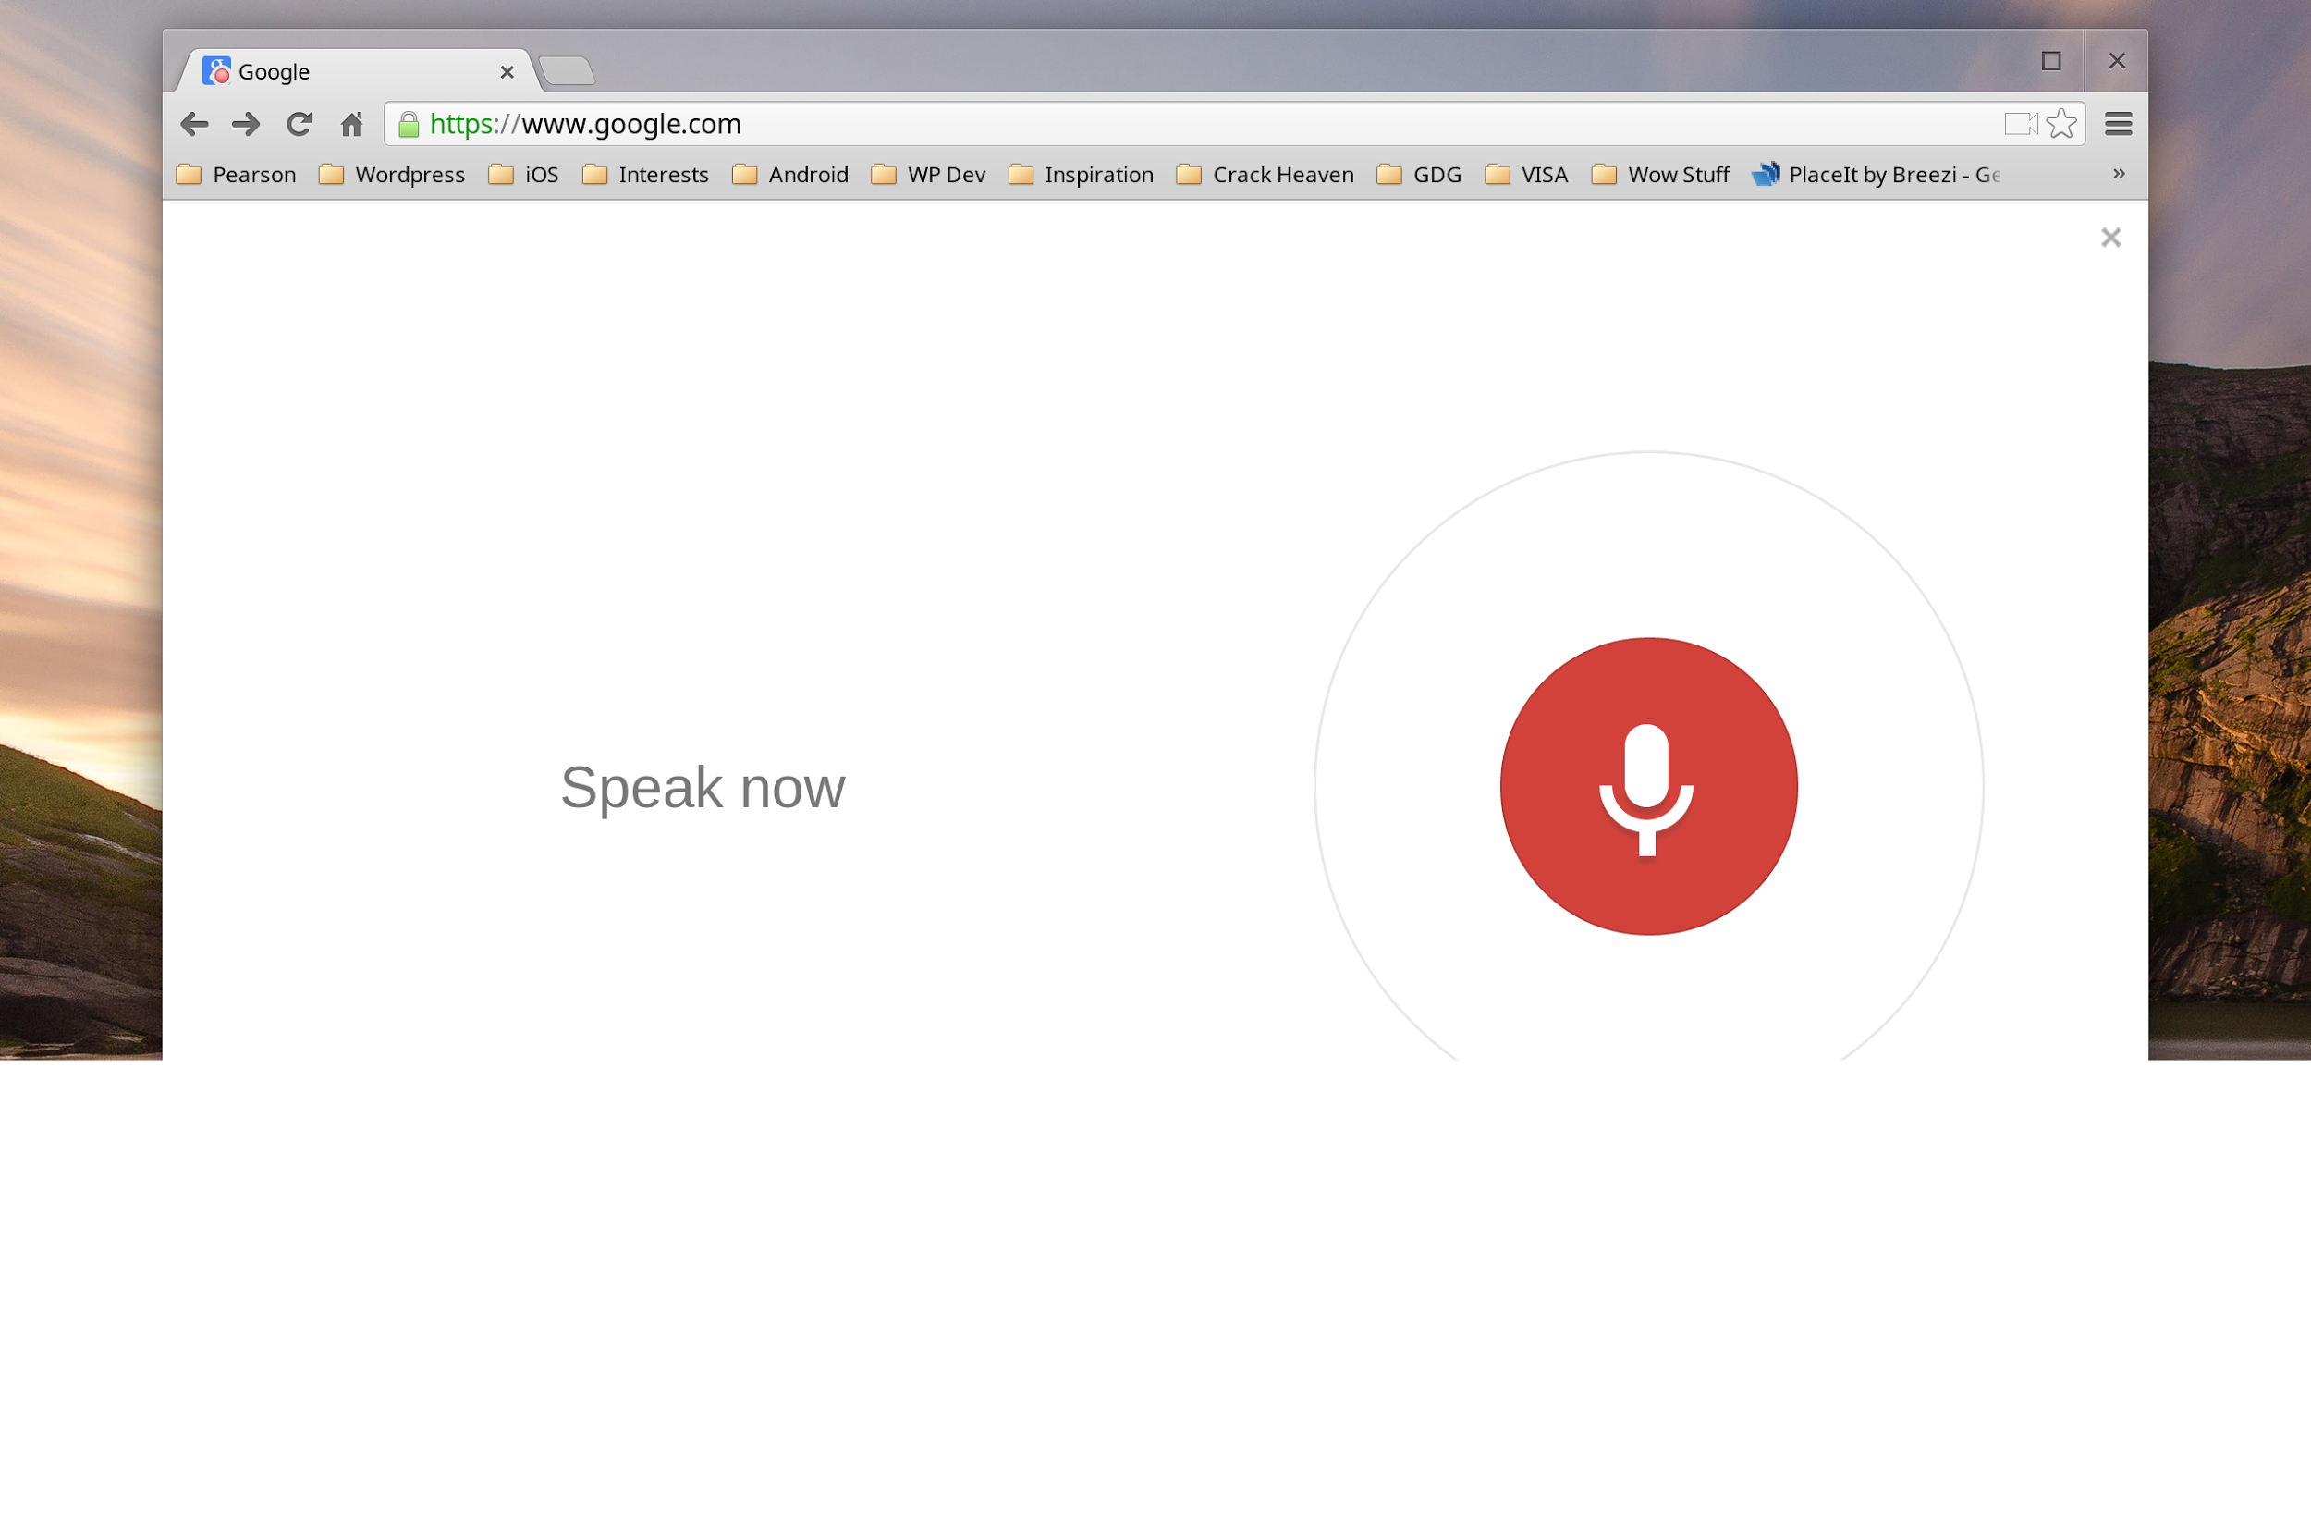
Who am ?

Slide 4
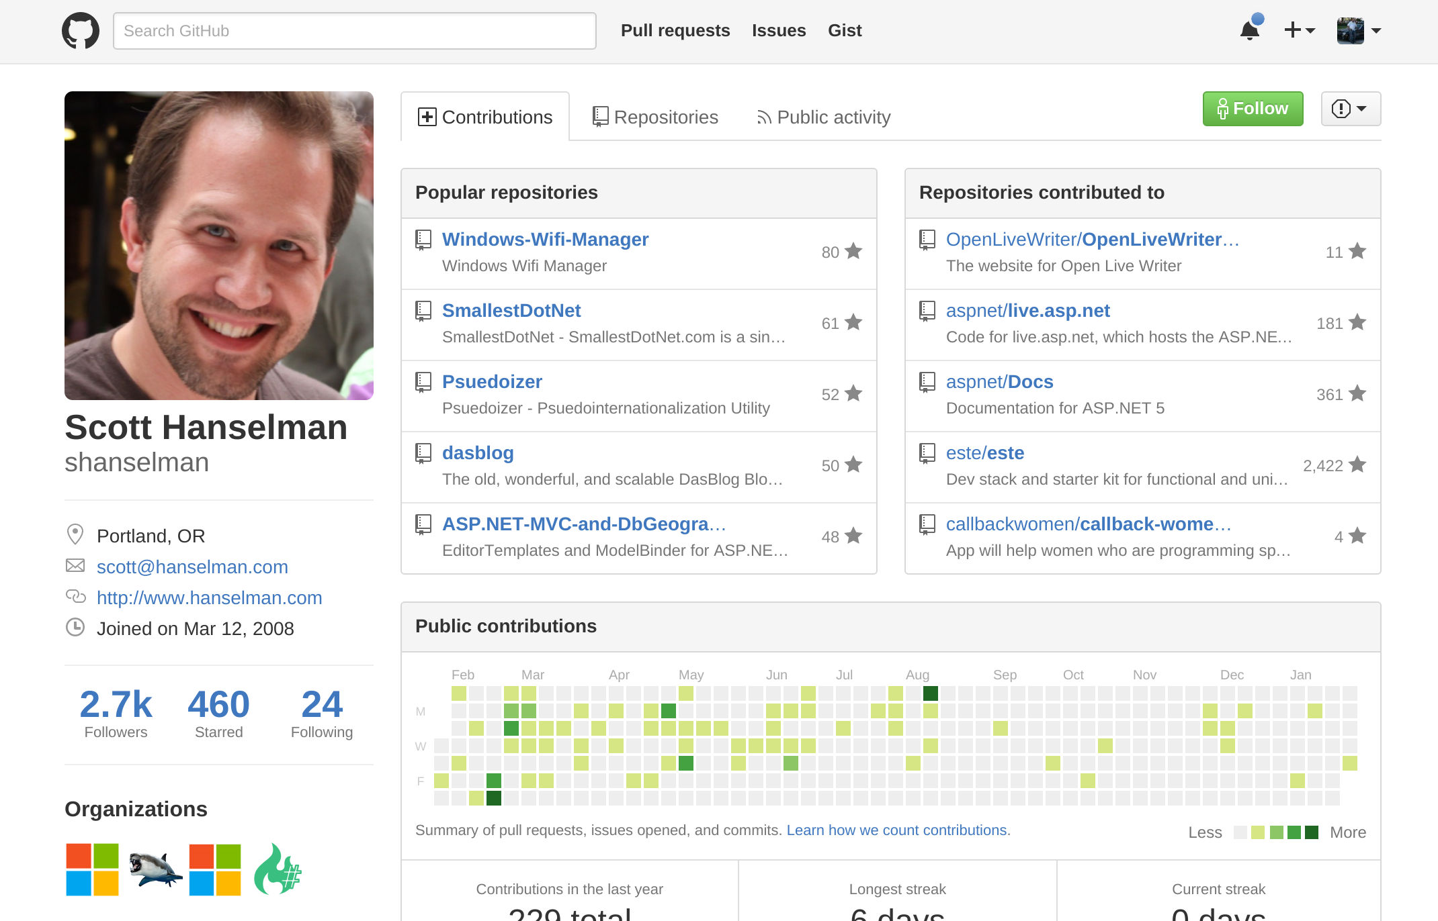

Slide 5
Who am ?

Slide 6
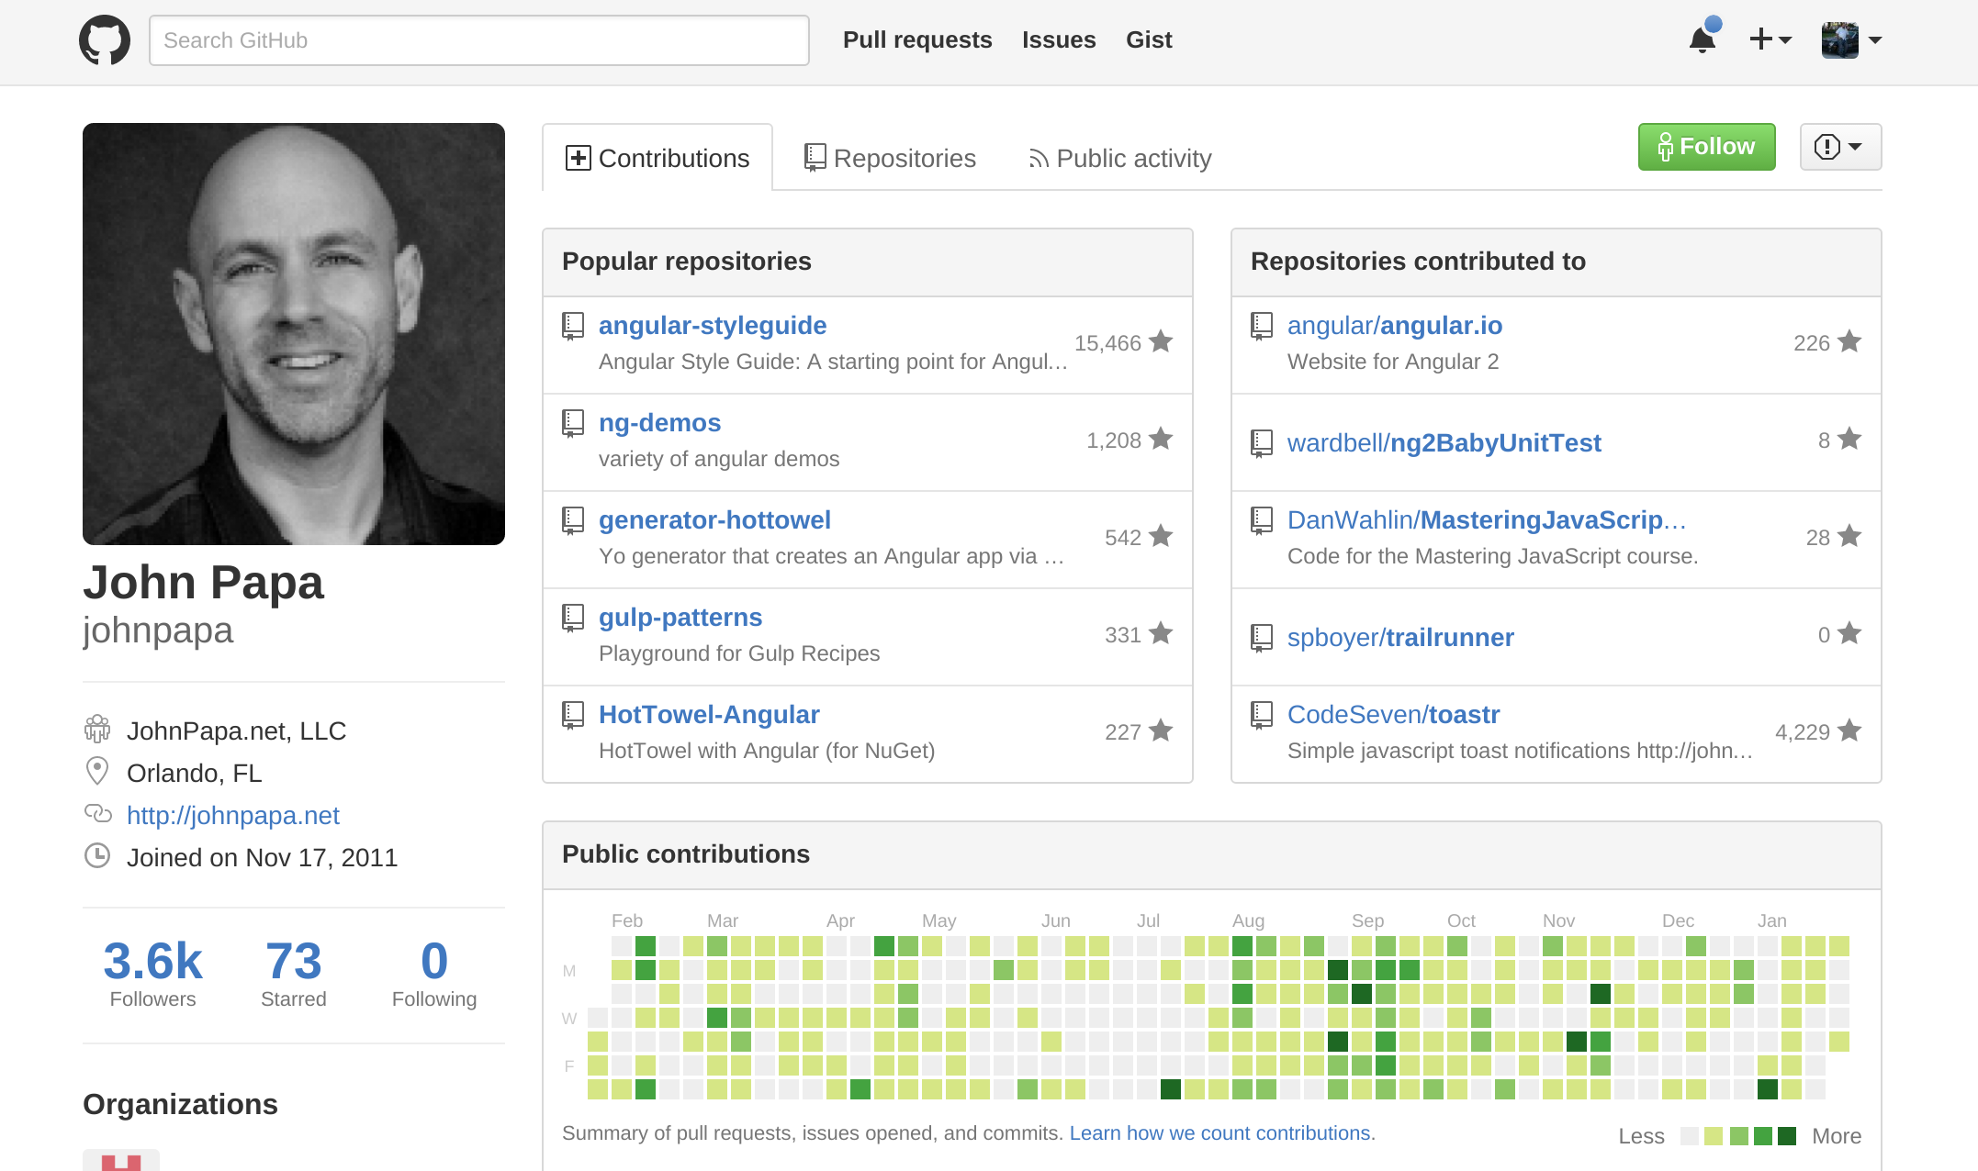

Slide 7
Who am ?

Slide 8
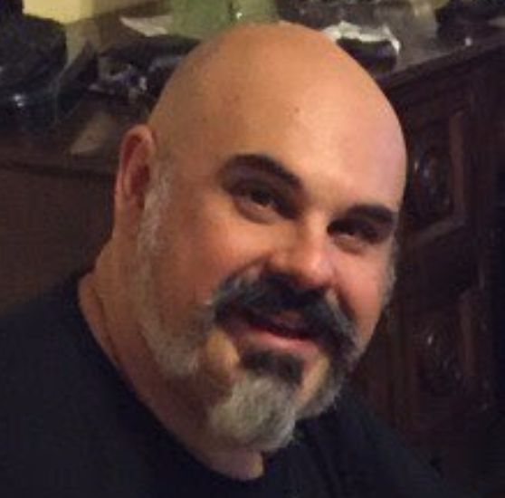
Damian
Montero
19 Years Web Developer
Worked for Skype, Microsoft, Circuit City (not my fault!)
5 Hackathon Wins
Including “Best HTML5 App” at the AT&T Developer Summit in Las Vegas
Teacher & Speaker
Let’s see you at Code Camp!

Slide 9


Slide 10


Slide 11
Walk the Walk
Let’s start with a demo!

Slide 12


Slide 13




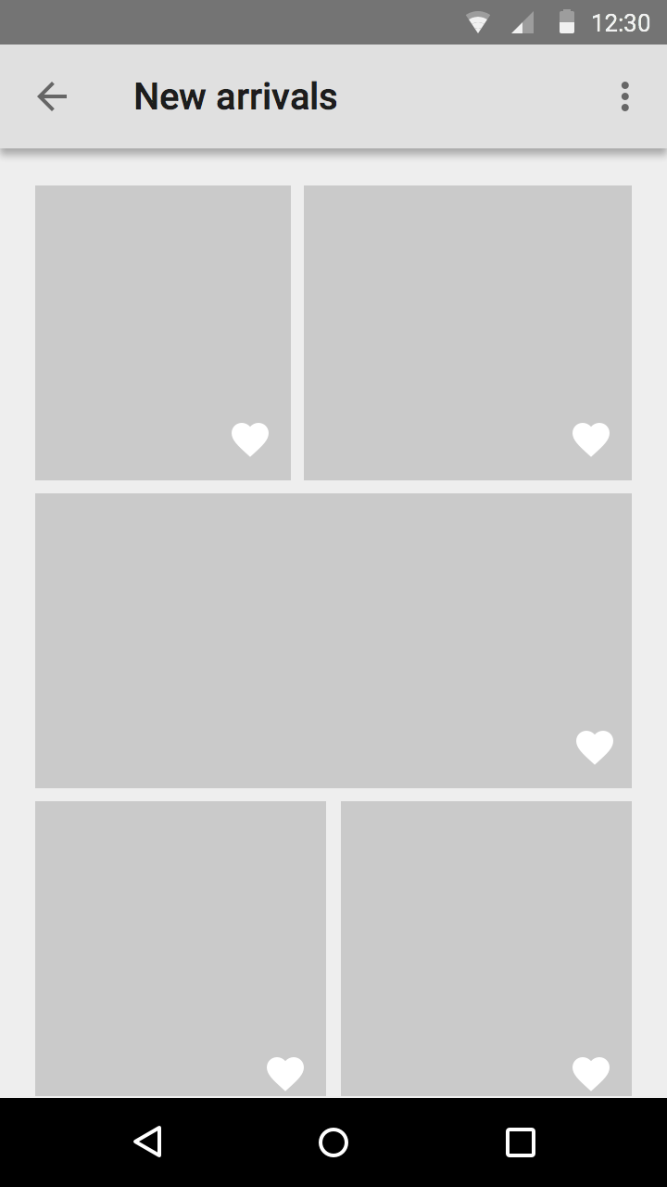
How we did it?
Check every second
Java or Flash
Magic?

Slide 14

WebSockets
It’s Magic!

Slide 15
Let’s see some code
WebSocketDemo.AzureWebsites.net or WebSocketDemo.HerokuApp.com

Slide 16
github.com/thedamian/websocket-node-example
var ws=new WebSocket(location.origin.replace(/^http/, 'ws')); ws.onmessage = function (event) { // Receiving from server var li = document.createElement('li'); li.innerHTML = JSON.parse(event.data); document.querySelector('#pings').appendChild(li); };
//send message to sever document.getElementById('stop').onclick=function(){ ws.send("stop"); };

Slide 17
github.com/thedamian/websocket-node-example
var WebSocketServer = require("ws").Server ... var wss = new WebSocketServer({server: server}) wss.on("connection", function(ws) { var id = setInterval(function() { if (RunMessage){ws.send(JSON.stringify(new Date()),function(){ });} }, 1000) ws.on('message', function incoming(message) { switch(message) { case "start": RunMessage = true; break; case "stop": RunMessage = false; break; } }); // on connection

Slide 18
Sockets.io & SignalR
doing it smarter
Ajax Long Polling
Sockets
Endless Javascript
ForeverFrame

Slide 19


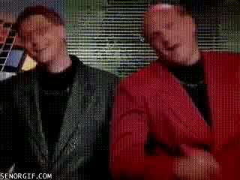

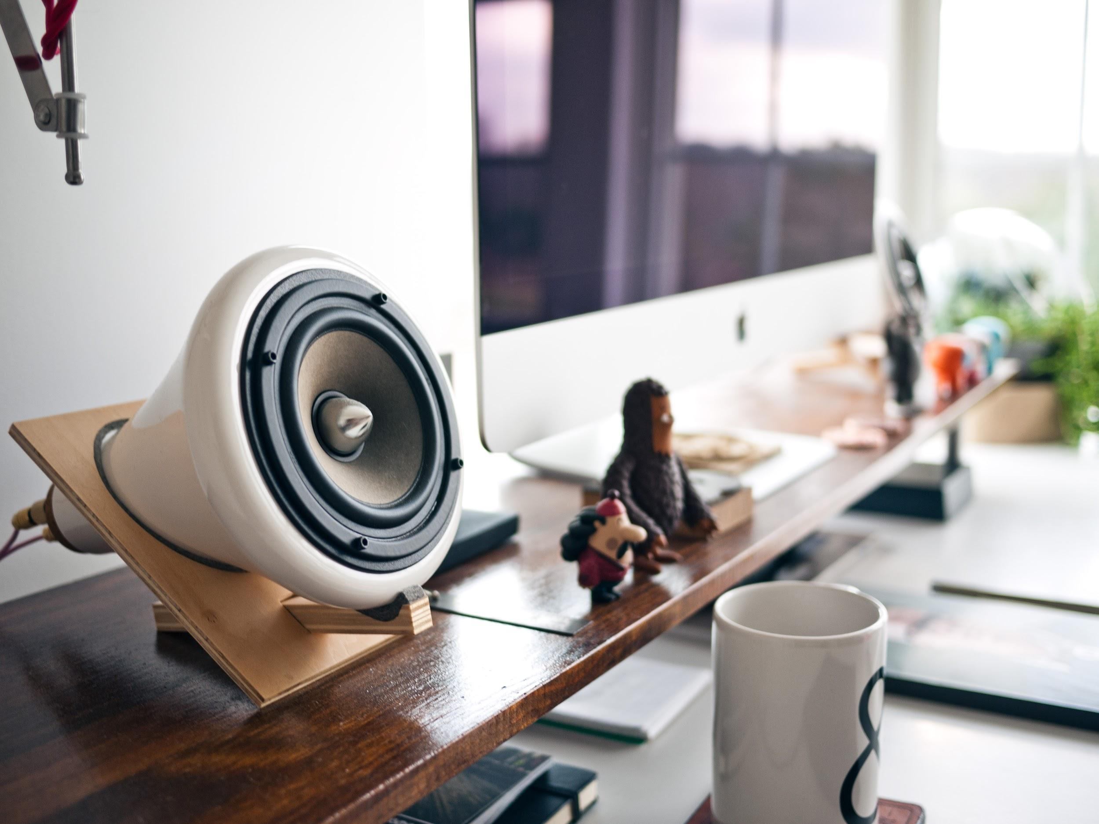


Socket.IO
SignalR
Open source, started in node, available in a lot of platforms.
Open source. a microsoft product, the first to use all four “tricks”

Slide 20
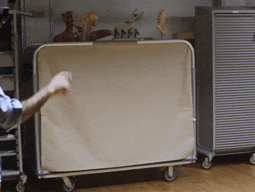
Socket.IO
SignalR
Open source, started in node, available in a lot of platforms.
Open source. a microsoft product, the first to use all four “tricks”

Slide 21
Notifications
Or how to get them back!

Slide 22
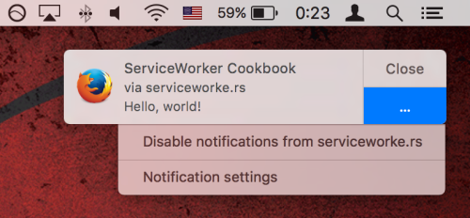
Chrome Safari & now Firefox have them

Slide 23
How to:
http://deanhume.com/Home/BlogPost/ push-notifications-on-the-web---google-chrome/10128

Slide 24

Resources
Twitter: @DamianMontero
github.com/thedamian
socket.io
asp.net/signalr
Notification example:
jsfiddle.net/pksLuhys/
BocaJS: @BocaJavaScript

